Slide 1
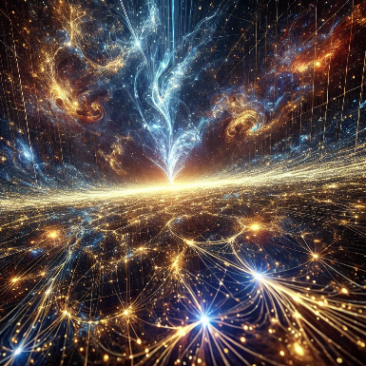

Insights from LLM Agents & Reasoning
Adrian Mladenić Grobelnik

Slide 2
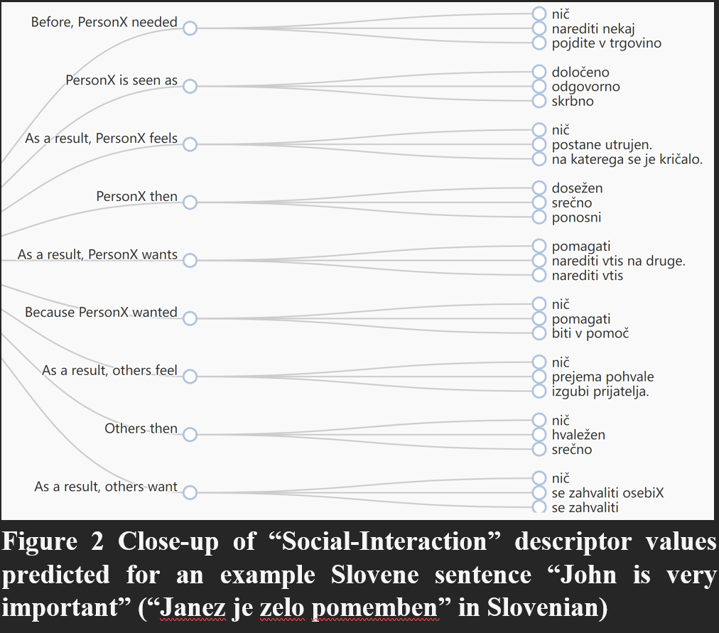
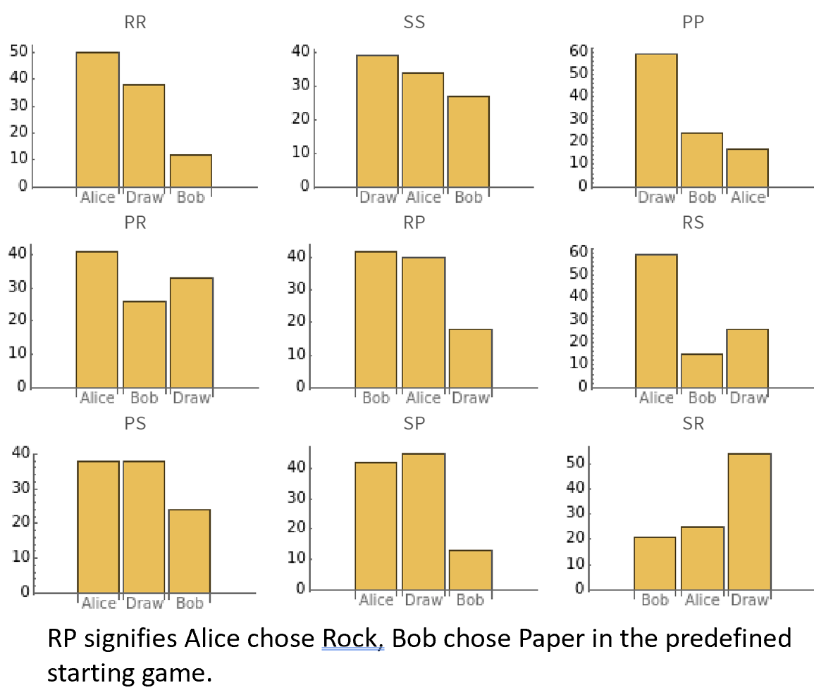
Development of LLMs
GPT-2: Coherent Text Completion & Finetuning
GPT-3.5+: Helpful responses, good at simple tasks
GPT-4+: Very good with human feedback, some reasoning

Slide 3
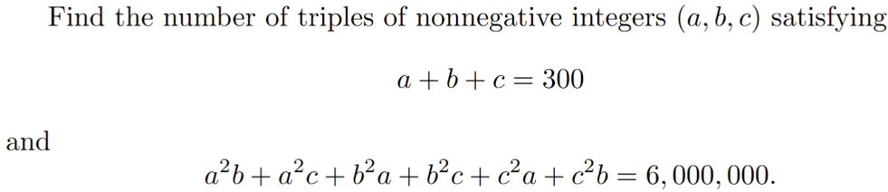
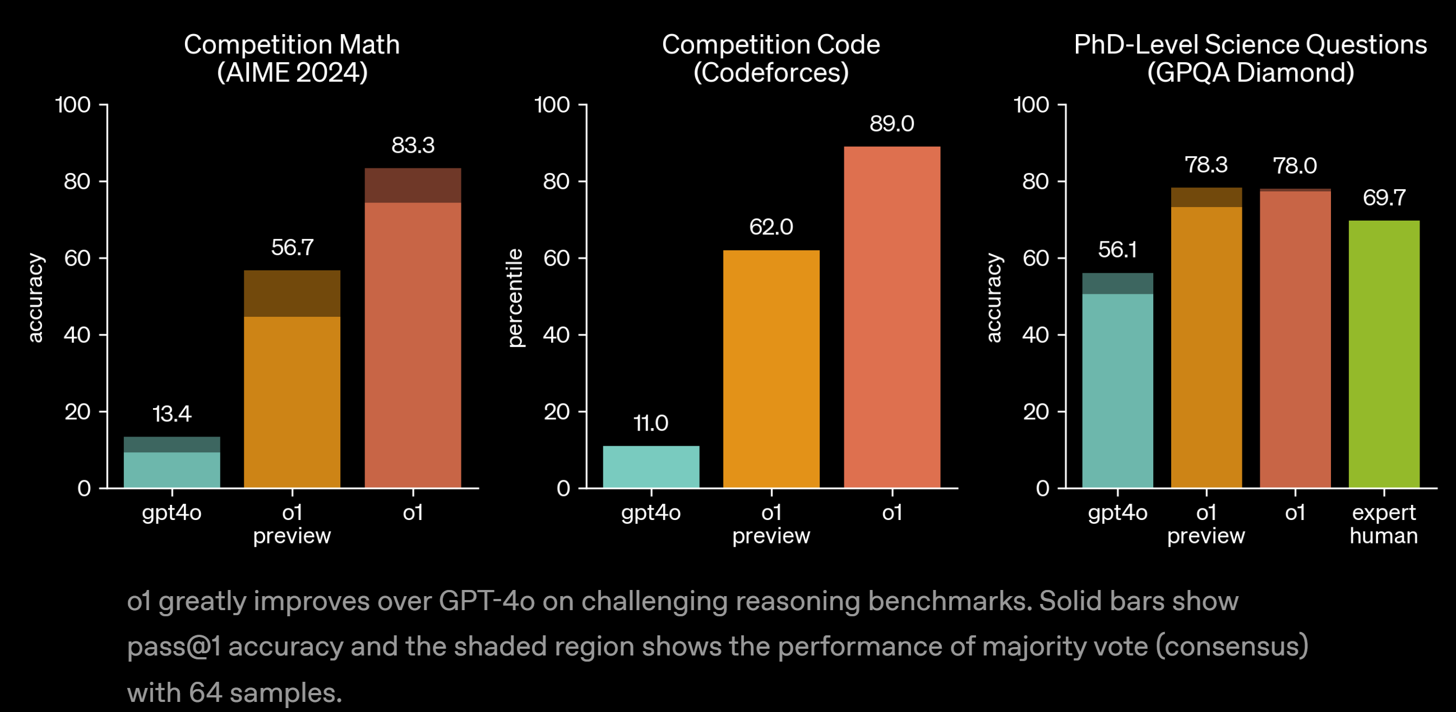
Development of LLMs (2)
o1, o3, DeepSeek-R1: Surpasses experts in math/coding

Slide 4
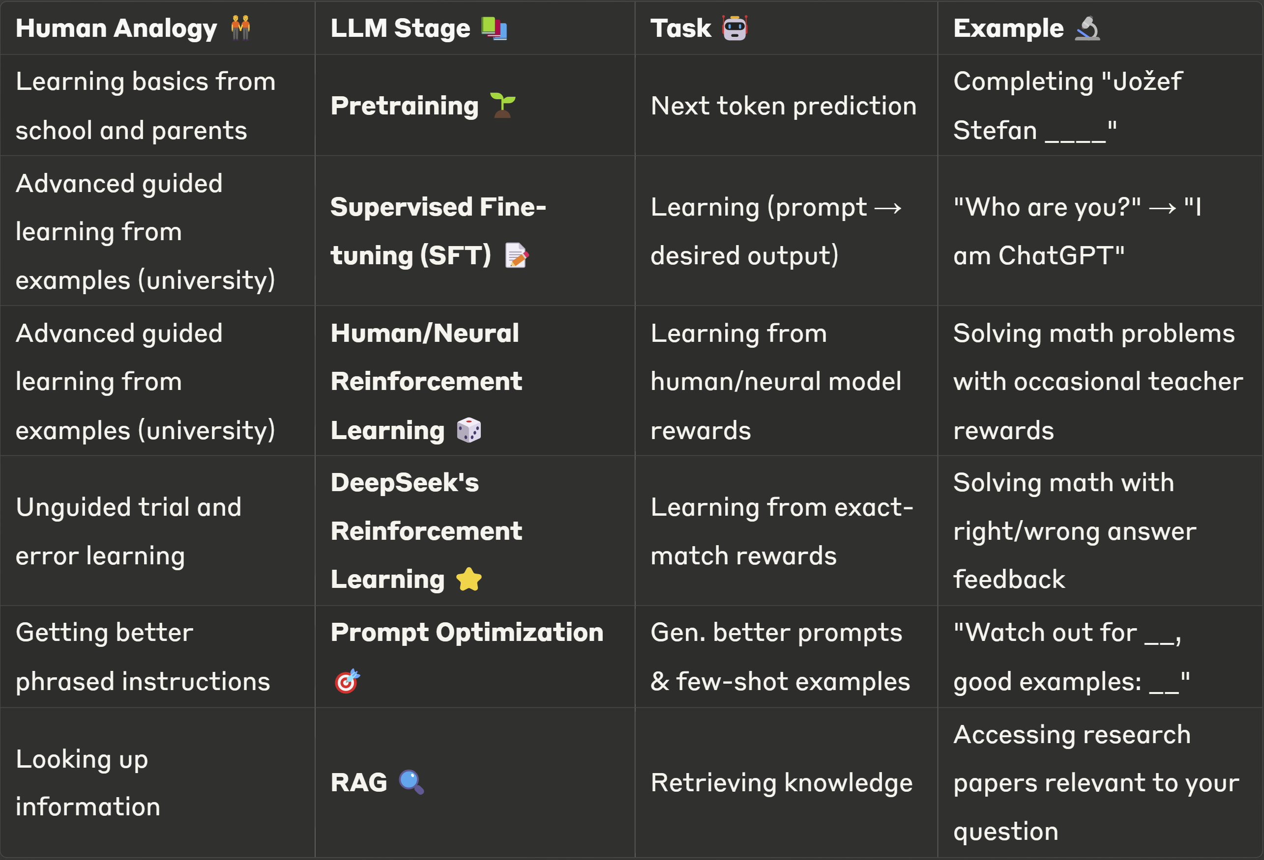
How do LLMs (and humans) Learn?

Slide 5
How do LLMs (and humans) Learn? (2)
Training Approaches:
  Classical: Pretraining → SFT → Human/Neural RL → (RAG/Prompt Optimization)
  DeepSeek-R1-Zero: Pretraining → Exact-match RL → (RAG/Prompt Optimization)
DeepSeek’s Innovation
  SFT bottleneck: Surface-level changes, human inconsistency
  Human/Neural RL bottleneck: Human inconsistency, neural reward model ‘hacking’
  DeepSeek's RL: Focuses solely on objective answer exact match

Slide 6
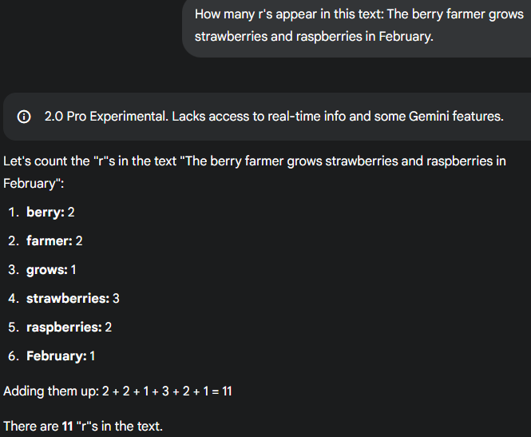
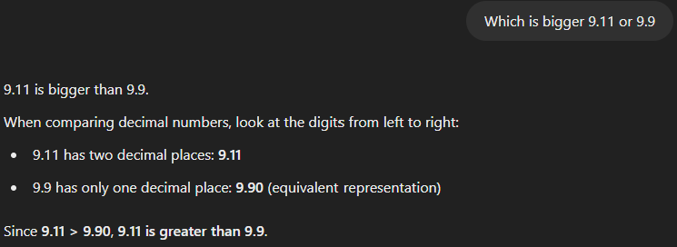
LLMs Generalize Poorly
Gemini 2.0 Pro Experimental (2025-02-05)
Which is bigger, 9.11 vs 9.9?
How many ‘r’ in strawberry?
ChatGPT-4o-latest (2025-01-29)

Slide 7
LLMs Generalize Poorly (2)
LLMs don’t generalize as well as humans
Mostly overfits to (advanced) patterns

Slide 8
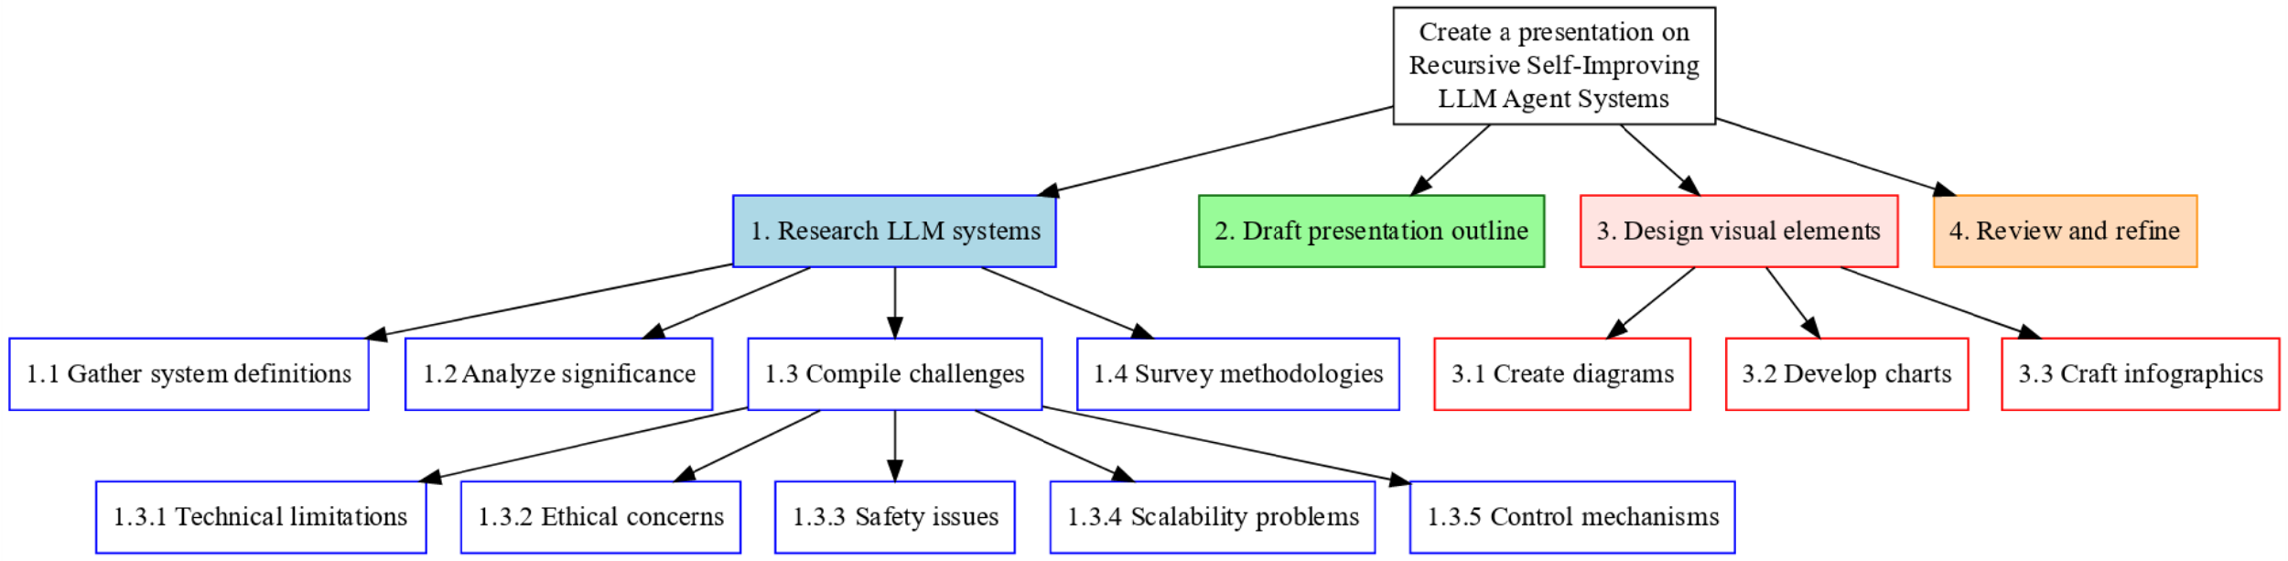
LLMs Generalize Poorly (3)
Idea: Use LLM to create qualitative ‘fill in the blank’ CoT reasoning tasks
  gpt-4o and o3 perform equally well❌
Idea: Solve complex problems with recursive multiagent systems
  Can delegate qualitative tasks ✅ Can't evaluate completion ❌

Slide 9
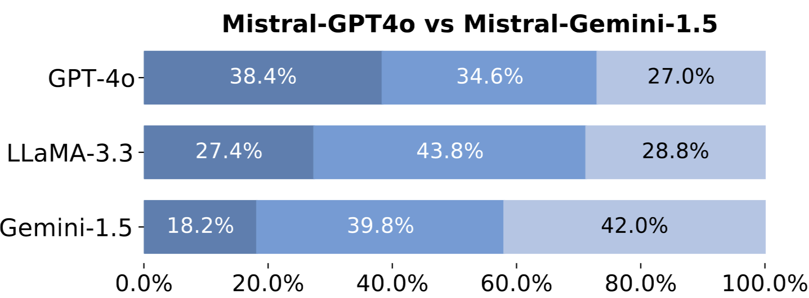
LLMs Generalize Poorly (4)
Idea: LLM-as-judge to evaluate LLM performance on predefined tasks
  Show systematic bias toward similar/student models ❌
  Inconsistent grading, only good for rough picture ❌
Idea: Get LLM to create multiple LLM multiagent systems
  Coding multiagent systems ✅ Design & prompting❌
_{Mistral-[Finetuned on]}
LLM Judges

Slide 10
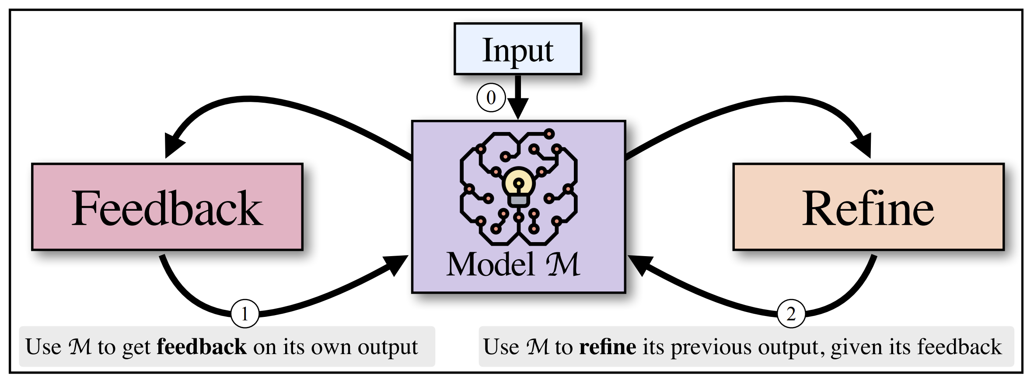
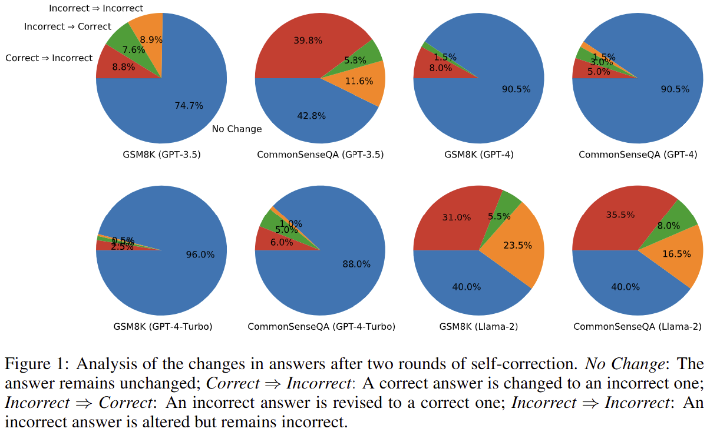
Deceiving Results
Many ‘small’ details can
greatly influence results
Self Refine: NeurIPS 24’, 1k citations, CMU & AllenAI
  Optimized few-shot examples only for Feedback/Refine
LLMs Can’t Self Correct Reasoning: ICLR 24’, 300 citations, Google
  Self-refine Issue: “Sub-optimal prompt design”
  Instructions critical to the task only included in Feedback Prompt
    (e.g. the generated code should be efficient, the sentiment should be positive/negative)

Slide 11
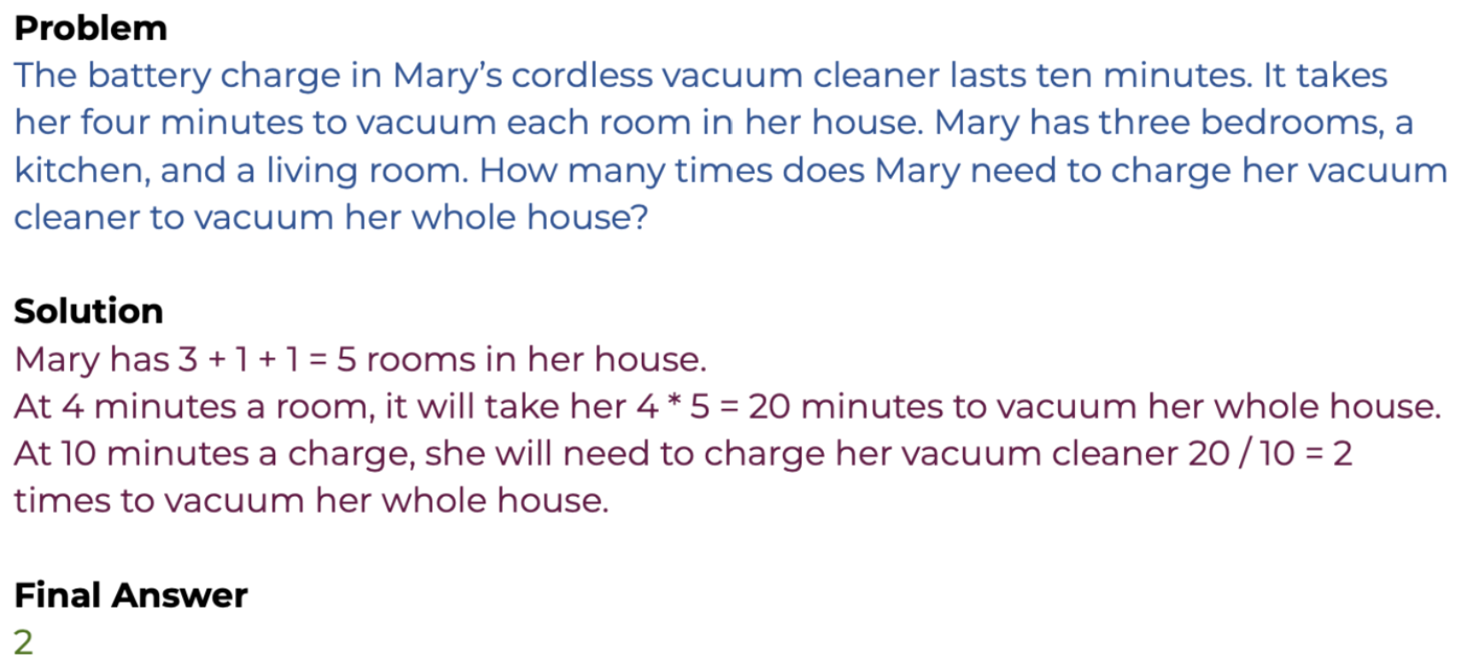
Deceiving Results (2)
LLMs overfit to benchmark answers
  GSM8k, grade school math (80%→70%)

Slide 12
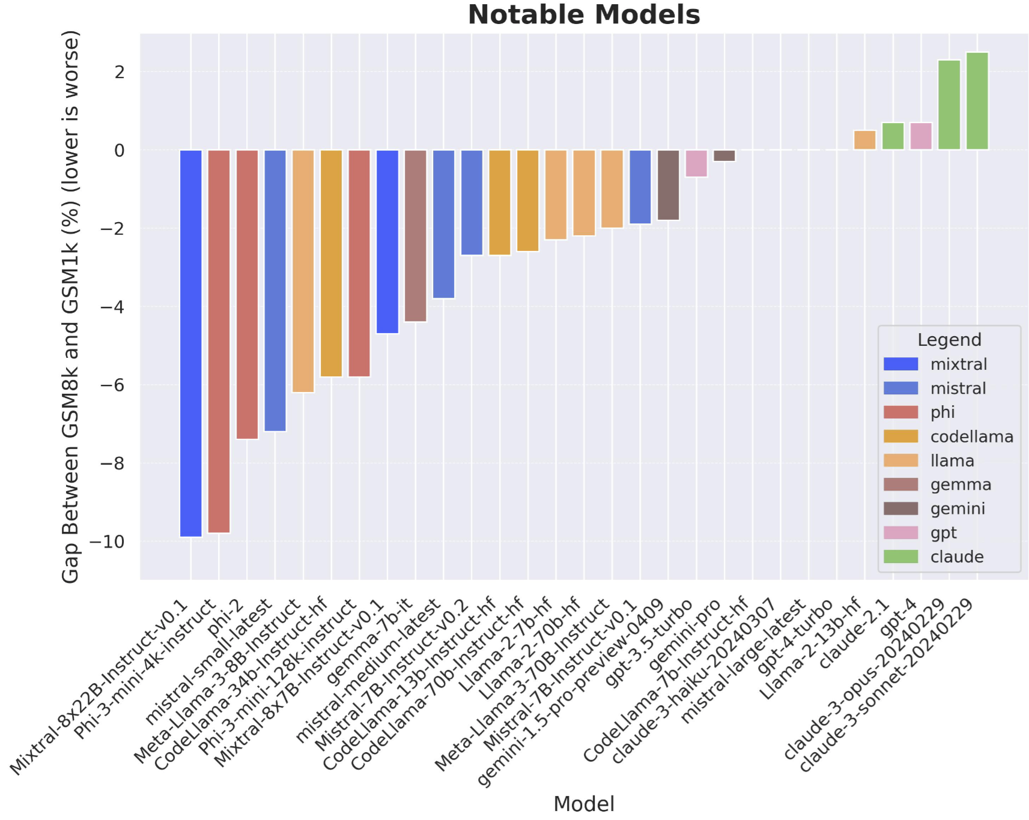
Deceiving Results (2)
LLMs overfit to benchmark answers
  GSM8k, grade school math (80%→70%)

Slide 13
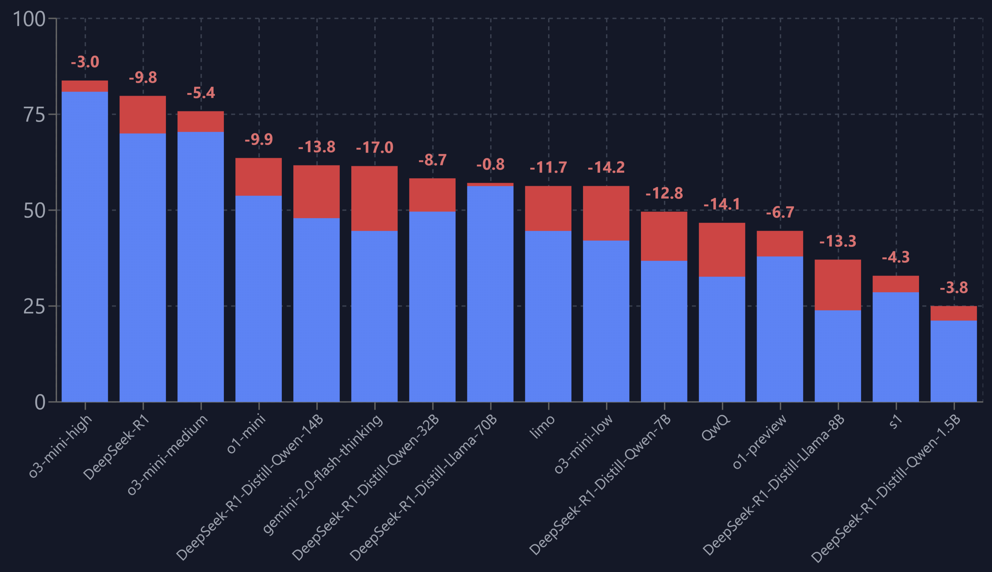
Deceiving Results (3)
Reasoning LLMs overfit even more
LLM distillation
  Large LLM → ✅Reasoning Traces → Teach small LLM
  Stanford s1: Qwen32B + 1k (Question, Synthetic Reasoning, Answer) = o1-mini level reasoning
  Deepseek-R1?
AIME 24' vs 25' Performance Drop

Slide 14
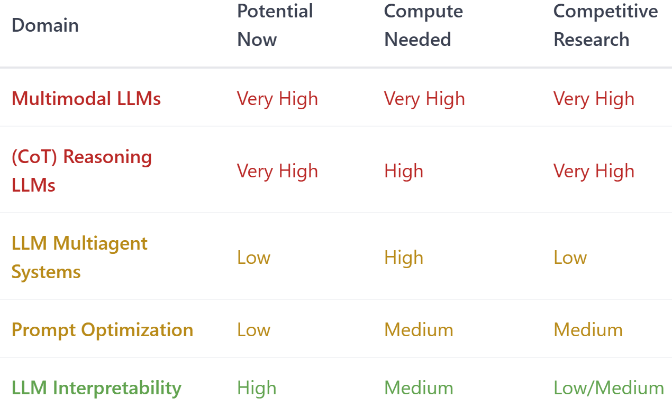
Research Domains
Competitive Research (based on citations of key papers):
  Very High → 1k+, Medium → 100+, Low → 50+

Slide 15
Concluding Points
LLMs are pattern composers. So are we.
Compute (or highly consistent data) is everything.
Think outside the box, and three steps ahead.

